Slide 1
CrowdTarget: Target-based Detection of Crowdturfing in Online Social Networks
*Jonghyuk Song, ⁺Sangho Lee, ⁺Jong Kim
*Frontier CS Lab@Samsung Electronics
⁺Pohang University of Science and Technology (POSTECH)
2015. 10. 14.

Slide 2
Crowdsourcing & Crowdturfing
Crowdsourcing → “Crowd” + “Outsourcing”
Distributing tasks to a large number of online users
(Amazon Mechanical Turk, Microworkers, …)
e.g., Translating, labeling, voting, …
Crowdturfing → “Crowdsourcing” + “Astroturfing”
Malicious usage of crowdsourcing
e.g., increasing website traffics, boosting OSN popularity (retweet/like/comment, …)

Slide 3

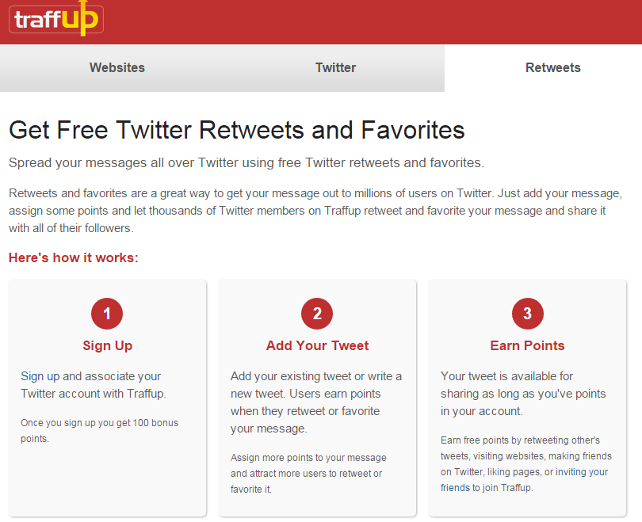
Examples of Crowdturfing Sites

Slide 4
Crowdturfing Services for Online Social Networks (OSNs)
Crowdturfing Service
Online Social Network
Crowdturfing task
(e.g., RT, like, comment…)
C
Boosting
W
C
W
Boosting
Payment
(virtual money)
C
Customer
W
Worker

Slide 5
Crowdturfing Services v.s. Black-market Services
Black-market
service
Money
Crowdturfing service
boosting
User
User
User
Order
reward
Boosting
Botnet
Users boost and reward each other.
Workers → Users (humans/human-like bots)
Users pay money and then black-markets boost the users by using botnet.
Workers → Bots

Slide 6
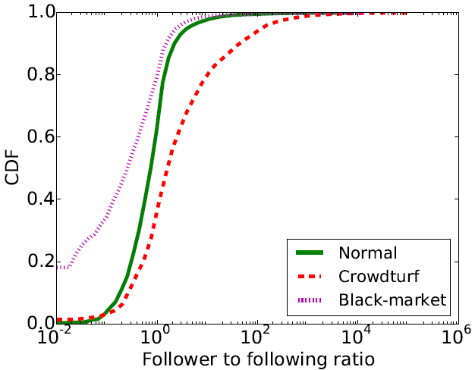
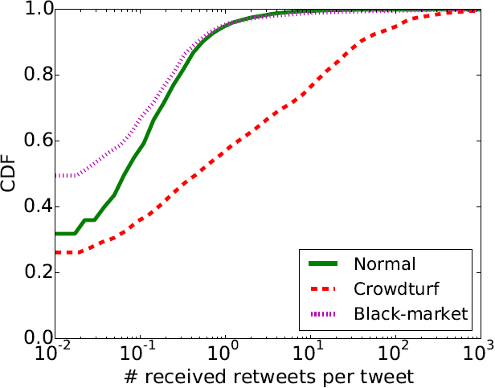
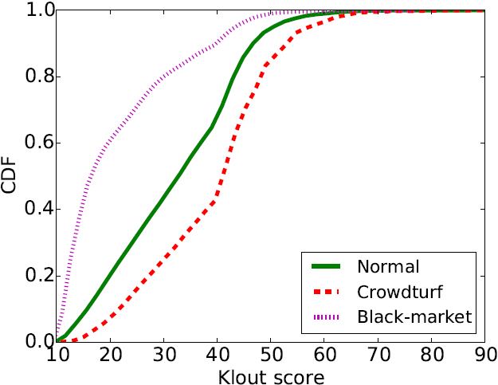
Crowdturfing Workers v.s. Black-market Workers: Popularity
Crowdturfing workers are more popular than normal/black-market workers.
Crowdturfing workers > normal > black-market workers
CDF
CDF
CDF
<Follower to following ratio>
<# received retweets per tweet>
<Klout score>
<Popularities of the three account groups>

Slide 7
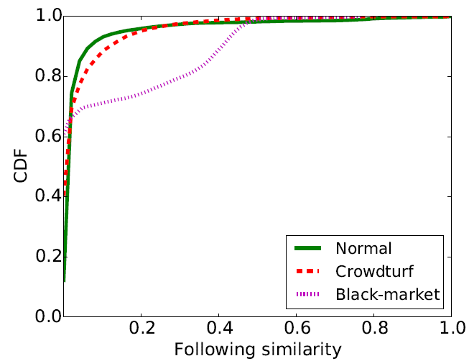
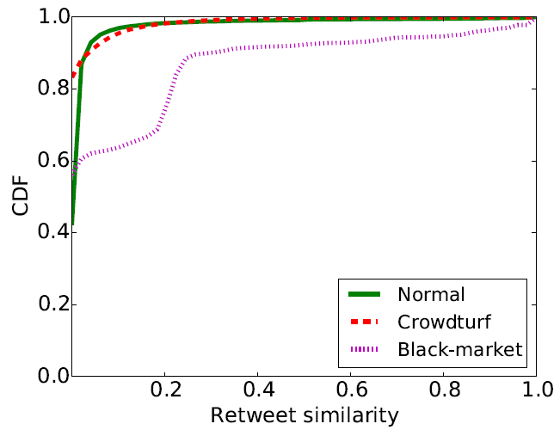
Crowdturfing Workers v.s. Black-market Workers: Synchronized Group Activity
Crowdturfing workers do not have group activity with each other.
They have similar tendency with normal accounts.
CDF
CDF
<Following similarity>
<Retweet similarity>
<Synchronized group activities of the three account group>

Slide 8
Can conventional bot detectors detect crowdturfing workers?
Account-based features (traditional)
Detect malicious accounts by using the characteristics of accounts
e.g., # of friends, contents of postings, popularity in OSNs, …
→ Crowdturfing workers have a high popularity and normal behaviors.
Synchronized-group activities (state-of-the-art)
Detect malicious accounts by using their synchronized behaviors
e.g., posting/sharing same contents at similar time, IP addresses, …
→ Crowdturfing workers act individually.

Slide 9
Motivation & Goal
We need a novel method to detect crowdturfing!
But, detecting crowdturfing workers → difficult
How about detect target objects of crowdturfing?
Detect target objects of crowdturfing in OSNs
We detected tweets retweeted by crowdturfing services.
(using target-based features, not account-based features)

Slide 10
Contents
Introduction
Analysis
Retweet time distribution
Dominant application
Unreachable retweeters
Click information
Evaluation
Conclusion

Slide 11
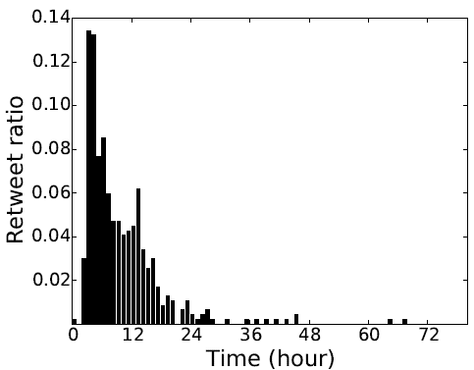
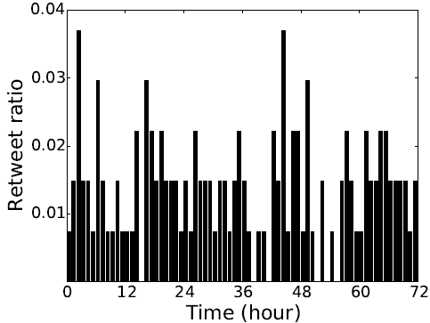
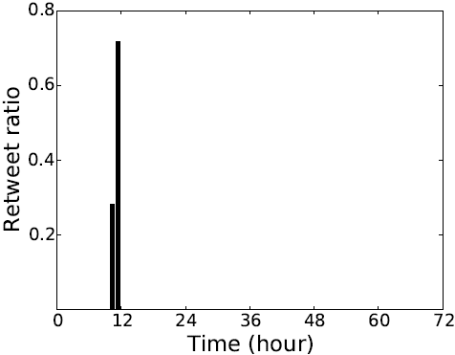
Analysis(1/4): Retweet Time Distribution
Retweet time distributions of each group differ from each other.
Retweet Ratio
Retweet Ratio
Retweet Ratio
Time (hour)
Time (hour)
Time (hour)
<Normal>
<Crowdturfing>
<Black-market>

Slide 12
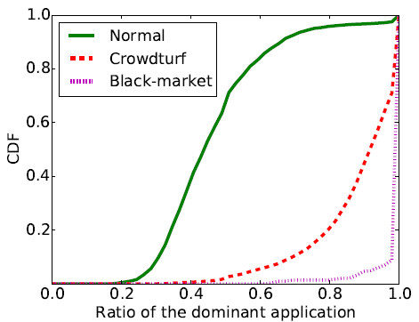
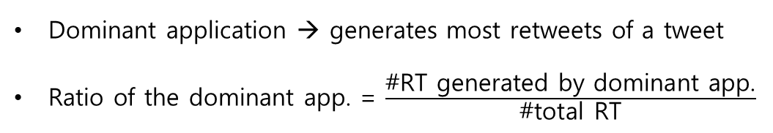
Analysis(2/4): Dominant Twitter Application
Normal tweets → retweeted by various Twitter applications
Abnormal tweets → retweeted by a few Twitter applications
Dominant application → generates most retweets of a tweet
Ratio of the dominant app. = $\frac{\text{\#}\text{RT} \text{generated} \text{by} \text{dominant} \text{app}\text{.}}{\text{\#}\text{total} \text{RT}}$
CDF
Ratio of the dominant application
<The ratio of dominant application used to generate retweets>

Slide 13
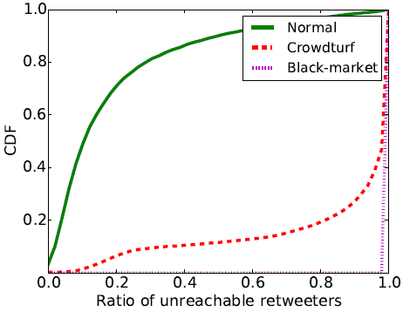
Analysis(3/4): Unreachable Retweeter
Normal retweeters → connected to the posting user
Abnormal retweeters → disconnected to the posting user
CDF
Ratio of unreachable retweeters
<The ratio of unreachable retweeters to a posting user>

Slide 14
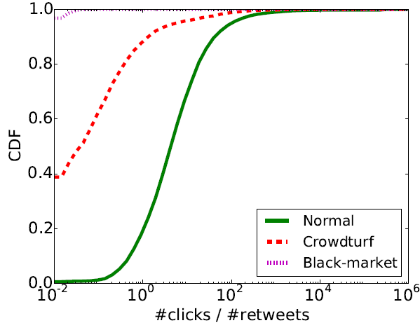
Analysis(4/4): Click Information
Normal → # clicks > # retweets
Abnormal → # clicks < # retweets
CDF
#clicks/#retweets
<The ratio of #clicks/#retweets per tweet>

Slide 15
Contents
Introduction
Analysis
Experiments
Overview
Data
Classification all tweets (without click info.)
Classification tweets containing links
Conclusion

Slide 16
Overview
et
unlabeled
tweet
Normal
Training
Classifier
RT time distribution
Dominant
application
Crowdturfing
Unreachable retweeter
Click
Information
Black-market
Normal
Malicious

Slide 17
Data
Normal tweets → verified account’s tweets
Crowdturfing tweets → posted on crowdturfing sites
Black-market tweets → manually purchase retweets from black-market sites
In real-world, malicious tweets are only 1% of the total.
→ We randomly duplicate normal tweets until #normal tweets ≥ 99 x #malicious tweets
We collected tweets from Nov. 2014 to Feb. 2015.

Slide 18
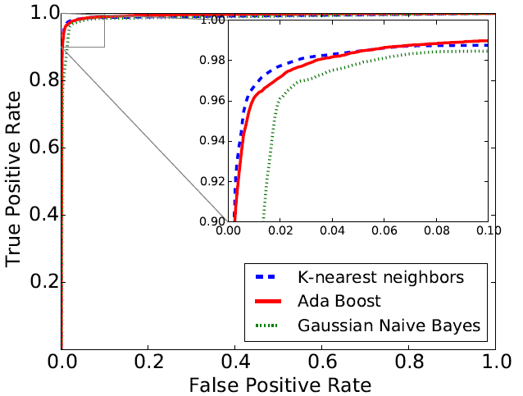
Classification all tweets (without click info.)
0.96 TPR at 0.01 FPR (k-nearest neighbors)
True Positive Rate
False Positive Rate

Slide 19
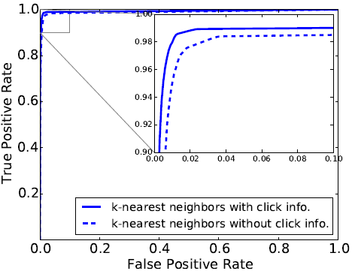
Classification tweets containing links
TPR is increased from 0.95 to 0.98 at 0.01 FPR.
True Positive Rate
False Positive Rate

Slide 20
Conclusion
The conventional bot detectors cannot detect crowdturfing workers.
So, we propose a novel method to detect crowdturfing.
Contributions
New detection approach
Detect crowdturfing targets, not workers
In-depth analysis
Analyze three groups: normal, crowdturfing, black-markets
High accuracy
0.98 true positive rate at 0.01 false positive rate

Slide 21
Thank You

Slide 22
Dataset
 | #Tweets | #Retweets | #Retweeters
Normal
Without URL | 10,318 | 914,974 | 390,275
With URL | 15,248 | 1,941,482 | 1,149,563
Total | 25,566 | 2,856,456 | 1,412,632
Crowdturfing
Without URL | 4,531 | 576,033 | 115,657
With URL | 14,867 | 1,866,843 | 110,295
Total | 19,398 | 2,442,876 | 190,800
Black-market
Total (w/ URL) | 282 | 71,858 | 41,829
Collected tweets posted by verified accounts
Collected tweets posted on crowdturfing sites
Manually purchased retweets from black-market sites
We collected the data from Nov. 2014 to Feb. 2015.

Slide 23
Error Analysis
False positives
Verified accounts using automated application
Tweet embedded in 3rd party websites
False negatives
Tweet retweeted in small #RT
Buy followers & retweets on the same crowdturfing service
The links distributed via many other tweets

Slide 24
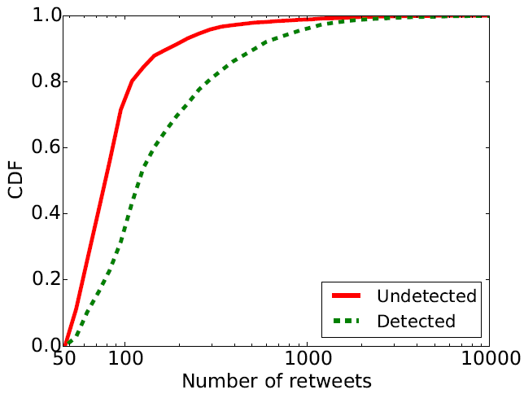
False-negative Analysis: # of Retweets
CrowdTarget could miss crowdturfing tweets if a tweet has small #RT.
About 75% of the undetected crowdturfing tweets are retweeted <= 100 times
It is not serious problem because their negative effects are limited.

Slide 25
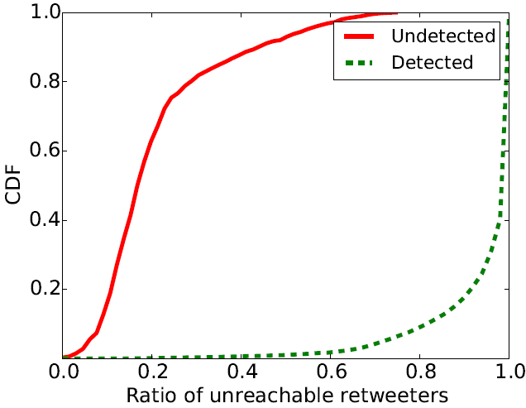
False-negative Analysis: % of Unreachable Retweeters
50% of the undetected crowdturfing tweets were mostly retweeted by reachable accounts.
We expect that some posting users of the undetected tweets bought followers on the same crowdturfing service.

Slide 26
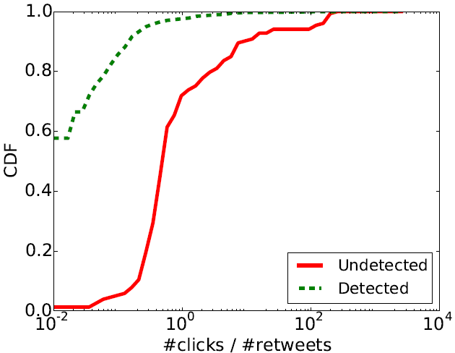
False-negative Analysis: # of Click
The links contained in the undetected tweets are distributed via many other tweets.
If we differentiate clicks per tweet, we can solve it.

